Slide 1

Student Details
Name: Gorantla Sravan Kumar
Skillbuild Email ID: gorantlasravankumar2003@gmail.com
College Name: Avanthi Institute of Engineering and Technology
College State: Andhra Pradesh
Intership Domain: Cyber Security
Intership Start and End Date: 13th October to 26th Novemeber

Slide 2
Hiding Message In An Image

Slide 3

Project Title
Hiding a message in an image is the process of concealing data or information within the visual content of an image in such a way that it is not readily apparent to casual observers. This technique, known as steganography, involves embedding the message in a manner that does not noticeably alter the image's appearance to the human eye. The hidden message can later be extracted using a specific decoding process or key, known only to the intended recipient, while the image itself appears unchanged to others. Steganography is often used for secure and covert communication or data protection purposes when used responsibly and legally.

Slide 4
Agenda
Hiding a message in an image involves a technique called steganography, where data is discreetly concealed within the pixels of the image. This hidden message is embedded using imperceptible alterations to the image's data, ensuring that it remains visually unchanged to human observers. The recipient can subsequently extract the message using the appropriate decoding method, provided they are aware of the steganographic technique and, if necessary, possess the required decryption key or password. Steganography is a useful tool for secure communication and data protection when used responsibly and ethically.

Slide 5

Project Overview
Data hiding is a characteristic of object-oriented programming. Because an object can only be associated with data in predefined classes or templates, the object can only "know" about the data it needs to know about. There is no possibility that someone maintaining the code may inadvertently point to or otherwise access the wrong data unintentionally. Thus, all data not required by an object can be said to be "hidden".
Data hiding in media, in images, video and audio, is of interest for the protection of copyrighted digital media, and to the government for information systems security and for covert (steganographic) communications. It can also be used in forensic applications for inserting hidden data into audio files for the authentication of spoken words and other sounds, and in the music business for the monitoring of the songs over broadcast radio.

Slide 6
The technology enables the insertion and recovery of hidden data in audio files through manipulation of the relative phase of harmonically related components of a host andio signal .Steganography is the art and science of writing hidden messages in such a way that no one apart from the intended recipient knows of the existence of the message. The word "Steganography" is of Greek origin and means "covered, or hidden writing". An encrypted file may still hide information using Steganography, so even if the encrypted file is deciphered, the hidden message is not seen.
Steganography used in electronic communication include steganographic coding inside of a transport layer, such as an image file, or a protocol, such as UDP. The advantage of steganography over cryptography alone is that messages do not attract attention to themselves, to messengers, or to recipients. A steganographic message (the plaintext) is often first encrypted by some traditional means, and then a hiddentext is modified in some way to contain the encrypted message (ciphertext), resulting in stegotext.

Slide 7

WHO ARE THE END USERS of the project ?
The end user of a steganography project could vary depending on its purpose and design. In a general sense, the end user might be individuals or organizations seeking secure communication methods. For instance, journalists, activists, or individuals concerned with privacy might use steganography to conceal sensitive information within seemingly innocuous files, ensuring secure transmission or storage. In a corporate setting, end users could be employees or departments using steganography to protect confidential data during transmission or within internal documents. Ultimately, the end user is anyone who benefits from the secure and stealthy transfer or storage of information facilitated by steganography.

Slide 8
The steganography project could vary widely. It might interest individuals seeking secure communication channels, like cybersecurity experts, intelligence agencies, or individuals concerned about privacy. Additionally, it could appeal to digital artists exploring hidden messages in their work or educators using it to teach encryption and data security concepts. Essentially, anyone interested in secure data transmission or intrigued by the art of hiding information within other data could be potential end users.

Slide 9

YOUR SOLUTION AND ITS VALUE PROPOSITION
There are various ways to hide messages in images, but a simple method is to use the least significant bit (LSB) technique. Here's a basic outline:
Choose an Image: Pick a cover image. It could be any image in which slight alterations won't be noticeable.
Convert Message to Binary: Convert your message to binary. Each character in the message can be represented by its ASCII code in binary.
Encode Message in LSB: Modify the least significant bit of each pixel's color value in the image to represent your message's binary. Small changes are less likely to be noticed.
Save the Modified Image: Save the new image with the embedded message.
Decoding: To retrieve the message, reverse the process—extract the LSB of each pixel's color value and convert the binary back to text.
Remember, this method is basic and may not be secure for highly sensitive information. Advanced steganography techniques exist for more robust hiding. If you're interested, I can provide more details or help with the coding!

Slide 10

How did you customize the project and make it your own
Customizing or creating steganography involves several steps. Firstly, you'd select the data you want to conceal, such as a message or an image. Then, you'd choose a cover medium where the data will be hidden, like an image, audio file, or even a text document. Next, you'd employ a steganographic technique, altering the cover medium in a subtle way that embeds the data without significantly changing its appearance or structure. This might involve techniques like LSB (Least Significant Bit) replacement, hiding data in the frequency domain, or using more complex algorithms for embedding. Customization could involve tweaking these techniques to fit your specific needs or creating your own algorithms to hide data in a unique way. Experimentation, understanding the principles, and adapting methods to suit your requirements are key in customizing or creating steganography.

Slide 11
Steganography involves concealing messages or information within other non-secret data. If you've completed a project related to steganography, you likely utilized techniques like hiding text within images, altering the least significant bits of pixels, or employing encoding methods to embed information within files. Projects often involve algorithms like LSB (Least Significant Bit) insertion or techniques in various media types to conceal data, demonstrating a practical understanding of covert communication methods

Slide 12
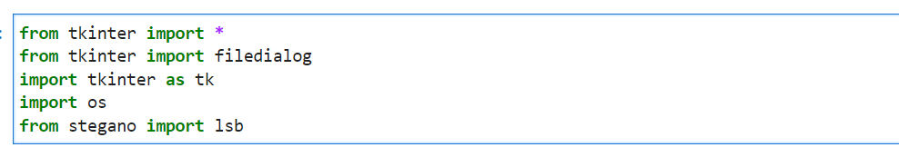
MODELLING
Initially imported the packages which are used
Pillow (Python Imaging Library): Allows manipulation of image files.
Stegano: A Python library for hiding data within images.
steghide: A tool used to embed and extract data from cover files.

Slide 13
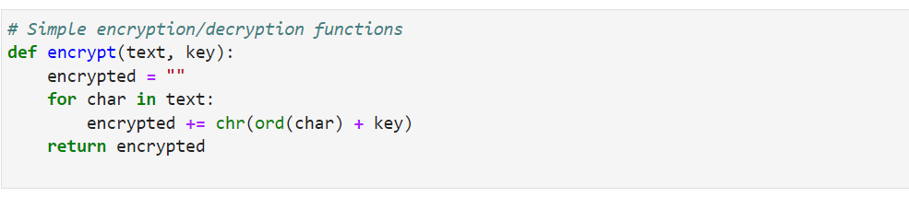
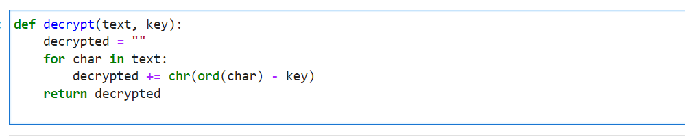

Slide 14
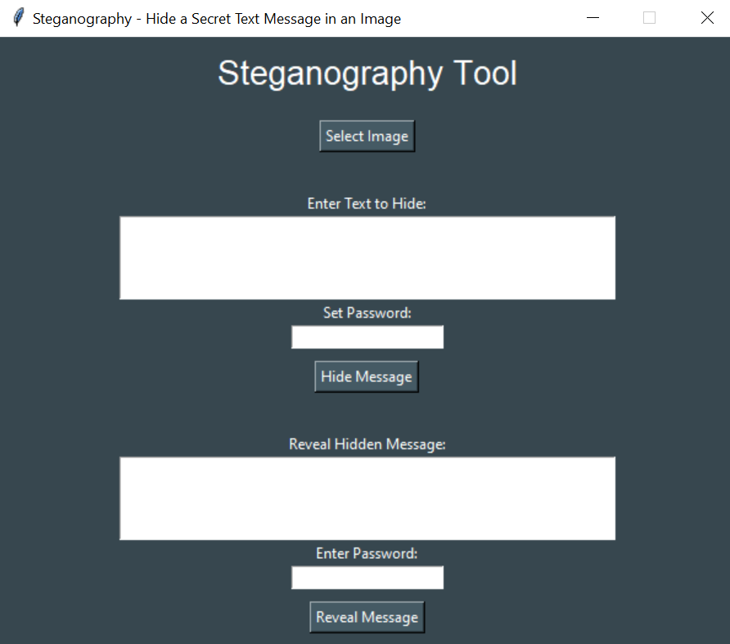
And then finally output for steganography

Slide 15
Results
Hiding a message in an image typically involves a process called steganography, where data is embedded within the pixels of an image in such a way that it is not easily perceptible to the human eye. The goal is to conceal the existence of the embedded message.
The final result of hiding a message in an image depends on the specific steganographic technique used. Common methods include:
LSB (Least Significant Bit) Substitution:
The message is embedded by replacing the least significant bits of the image pixels with the message bits.
The visual impact on the image is minimal, as the changes are typically imperceptible to the human eye.

Slide 16
Spread Spectrum:
The message is spread across the image by modifying the color values of pixels slightly.
Spread spectrum methods aim to distribute the changes across the image to make them less noticeable.
Transform Domain Techniques:
Frequency domain transformations like Fourier Transform or Discrete Cosine Transform can be used to hide information.
The message is embedded in the transformed domain, and it may not be obvious in the spatial domain.
Algorithmic Methods:
Complex algorithms can be used to embed information in images in a way that is difficult to detect without knowledge of the specific algorithm.

Slide 17
The success of steganography lies in the ability to conceal the message effectively. However, it's important to note that steganography is not foolproof, and sophisticated analysis techniques can sometimes reveal the presence of hidden information.
On the flip side, there are also methods for detecting the presence of hidden messages in images, and there is an ongoing cat-and-mouse game between those who create steganographic techniques and those who develop methods to detect them.

Slide 18
Links
I am providing the GitHub links you can check my code which containing the project focused on hiding messages in images using steganographic techniques requires careful consideration of the chosen method and its implications.
https://github.com/Sravan2206/IBM--stegnography-tool-

Slide 19
Thank You

